Slide 1
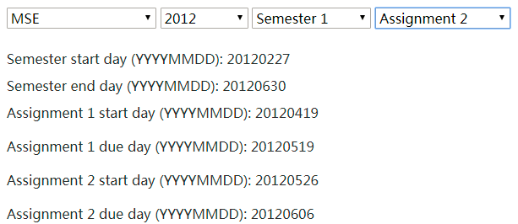
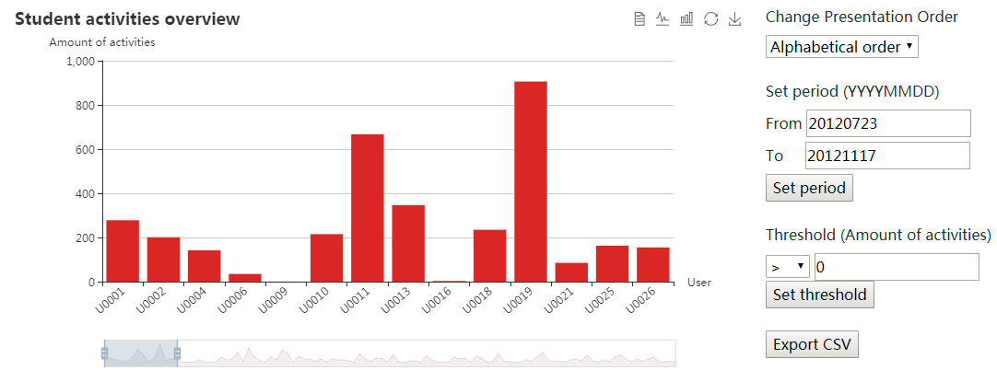
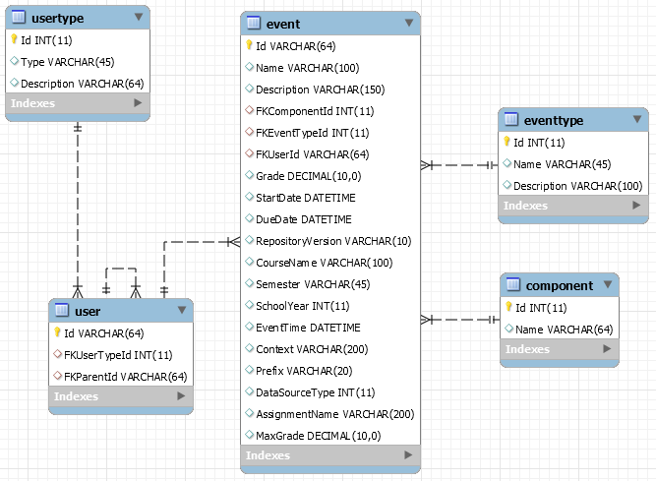
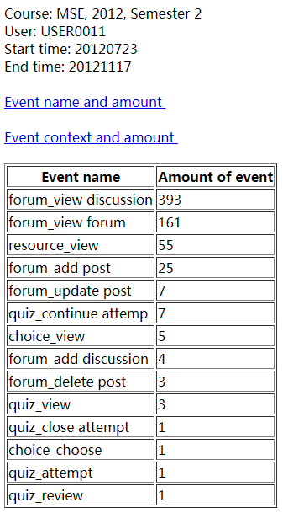
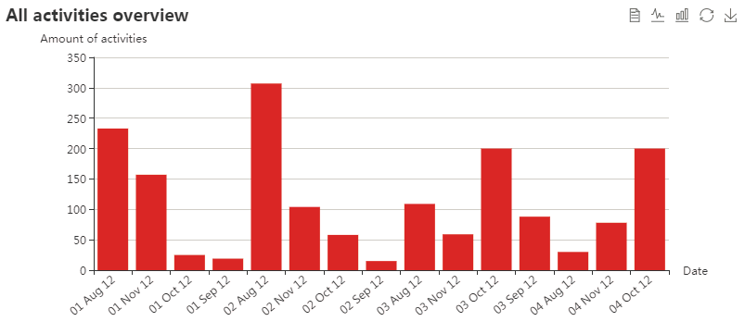
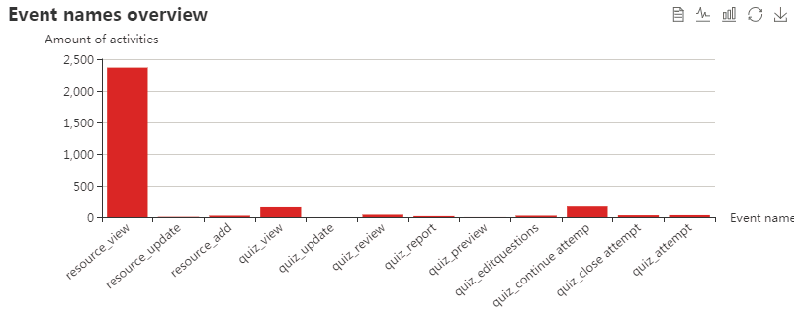
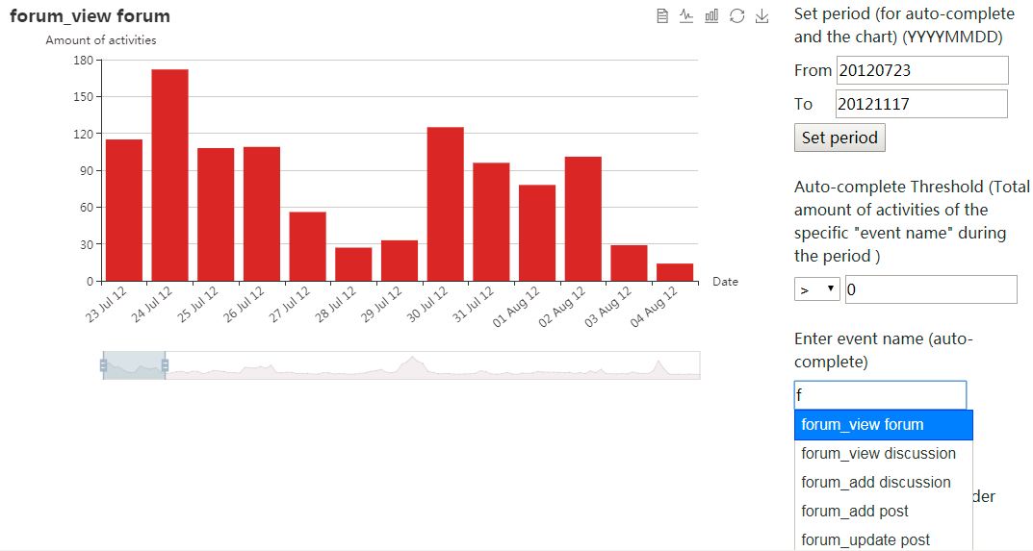
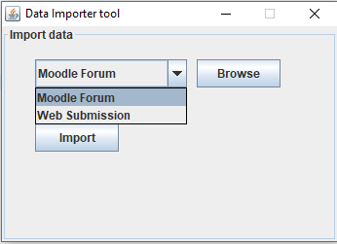
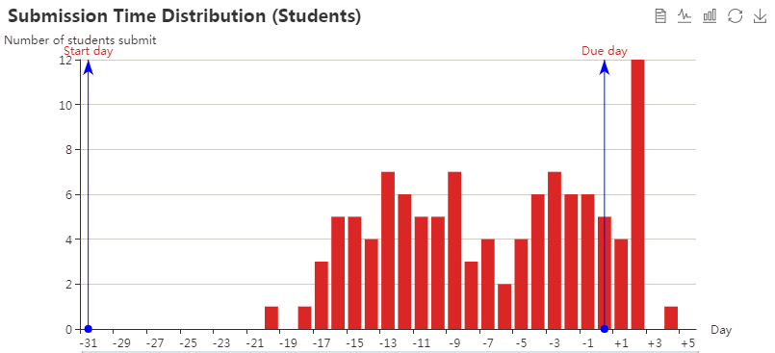
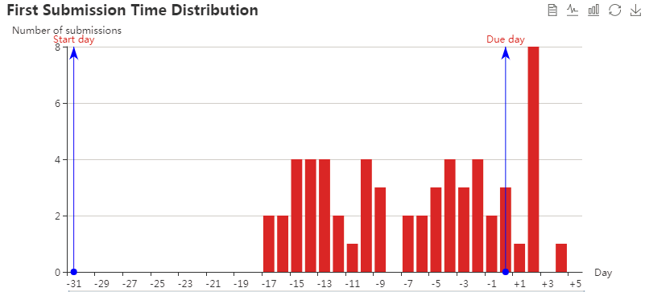
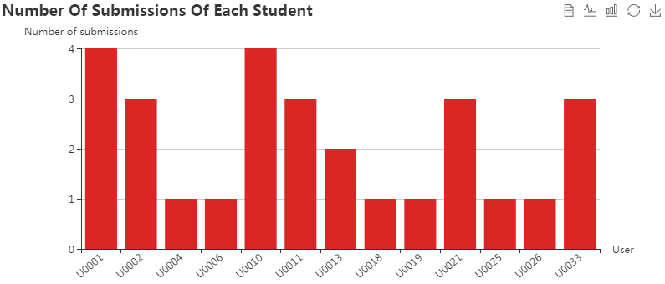
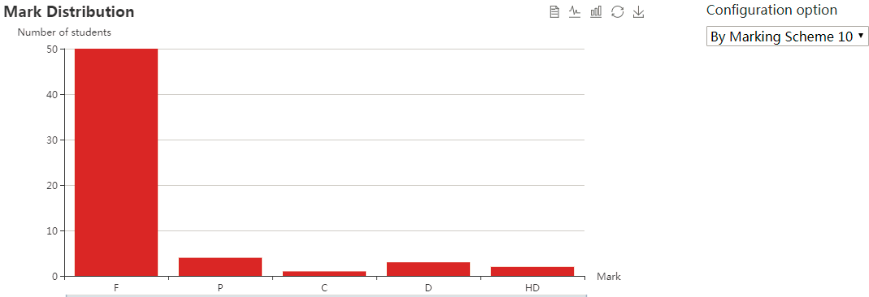
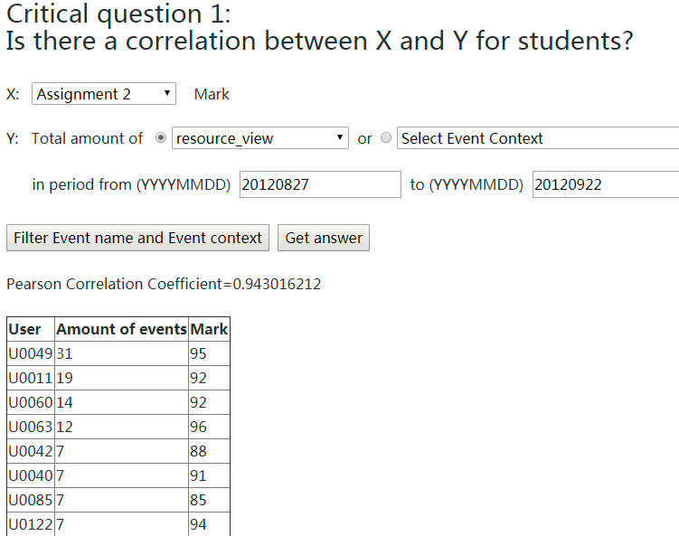
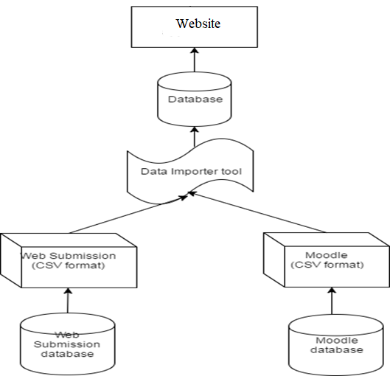
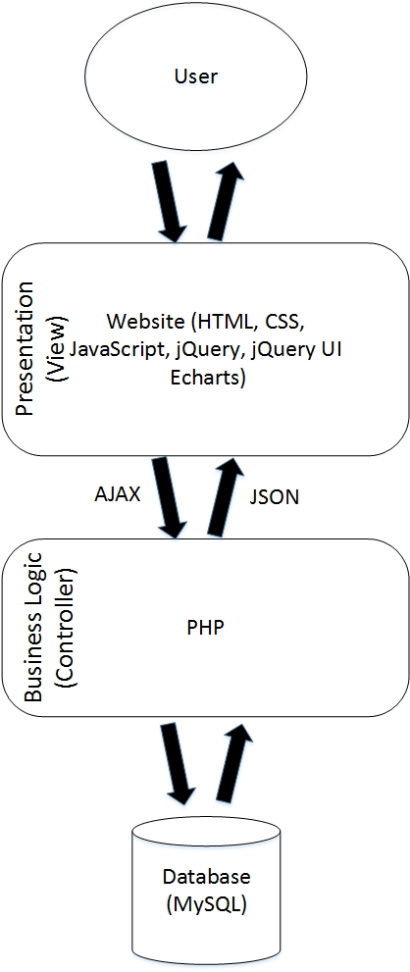
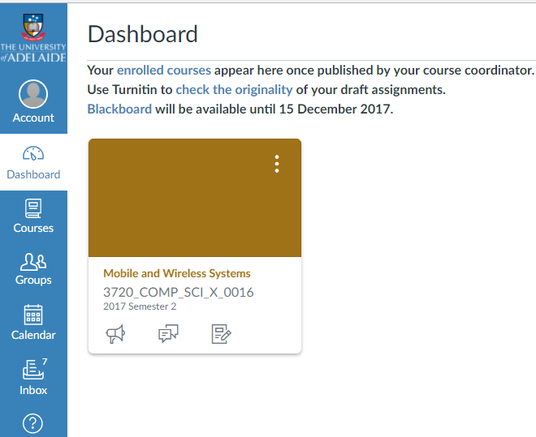
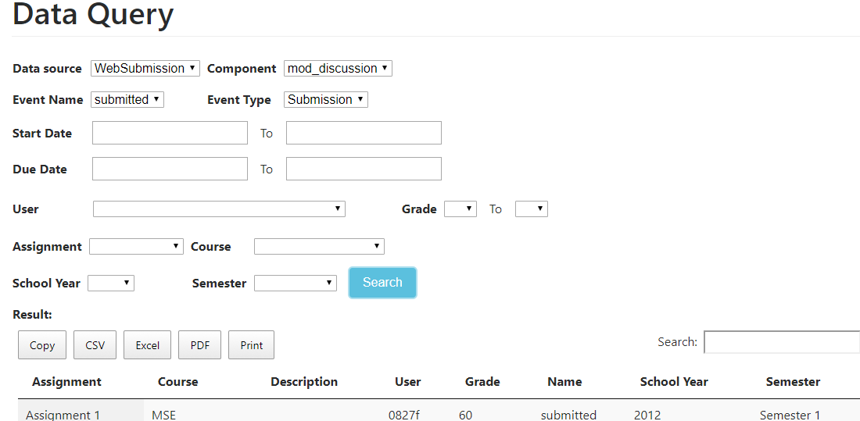
Organised Access to Historical Student Data
Zeyu Lin, Minh Tam Phan, Zeqi Fu (zeyu.lin, minhtam.phan, zeqi.fu) @student.adelaide.edu.au
Supervised by Nickolas Falkner, Claudia Szabo, Christoph Treude, Marian Mihailescu
School of Computer Science
Project Introduction
Charts and analysis module
Data importer tools
The school of computer science has got a large amount of student data collected over the years in a number of different sources. We have no easy way to collect that data represented in a neat visualized form to allow development decision making.
Activities of individual student
The database schema is built based on two data sources (Moodle Forum and WebSubmission).
Data Importer tool extracts data from data sources to database.
The website displays and analyzes data by charts and tables.
The website is designed in a decoupled way. It adopts two-tier model, which separates the front-end and the back-end.
Choose course, year, semester, assignment
Alphabetical, descending, ascending order
Clicking the bar will give details of activities
Project Objective
Filter data by threshold
Link two data sources (Moodle forum and WebSubmission system) and link the users (which are anonymized) of two data sources by designing a database schema .
Write extraction and insertion scripts (data importer) to import current file-based data.
Provide visualization of data by using charts and make them configurable to allow users to manipulate and interact with data. Configuration options include: change presentation order, set start day and end day, set threshold, set activity, set course, year, semester and assignment.
Analyze the relationship between the amount of students’ activities and academic performances.
Allow staff to query the database, aggregate it and export it (Copy, Print, CSV, Excel, PDF).
Automatically set
Export data in CSV format
Activities of the class
Amount of all activities
Breakdown of activities
Specific activity
The activity can be set
Provide visualization by using charts, which make the data intuitive and easy to read.
Provide lots of configuration options and related functions (set period, change presentation order, threshold function, export data in CSV format, event name/ event context auto-complete), which allow user to further explore and manipulate data.
Allow user to choose course, year, semester, assignment.
Provide data of individual student as well as the whole class.
Provide the amount of different events in a given period as well as the amount of specific event of each day.
Link two data sources and link the users of two data sources.
Provide cross data analysis: allow user to explore the relationship between the amount of students' activities and academic performances.
Auto-complete, choose the activity for this chart
Submission pattern
The class
Annotate assignment start, due day
When do students make first submissions?
Individual student
Data Query module can support staff to query and extract data.
This is a combined database of Moodle Forum and WebSubmission data sources.
This database can be flexibly applied for newly added data sources such as Canvas.
Data importing tool can assist to import data from data sources into database.
Relationship between activities and academic performances
System Architecture
Configurable, by Marking Scheme 10/ by 10% step
Automatically calculated
Future work
Link users of two data sources
Modify the schema to work with new data sources (Canvas).
Add new data sources (e.g. student GPA) for further cross data analysis.
Provide charts (across semesters) of the same course for trend analysis and comparison.
Data query module
The database is flexible and can be applied for multiple data sources.
Having tools to import data from external files.
Visualization makes the data intuitive.
Charts are configurable, which allows user to manipulate and further explore data.
Acknowledgement
This project was supported by the School of Computer Science. We gratefully acknowledge the feedback and contribution of Nickolas Falkner, Claudio Szabo, Christoph Treude and Marian Mihailescu.

